Slide 1
Develop sustainable solutions for the E- waste recycling.
HACKATHON
2021
INNOVATE AND INITIATE……

Slide 2
THE IDEA TO GO THROUGH IT….
One of the best way is to form a completely guided and affiliated organization which will be working as a trade-in/manufacturing firm.
Further , In this organization, people will be working upon designing versatile eco-ATMs as well as trading the iron waste for making more standardized railway sleepers from the waste.
In addition to this a team of certain expertise can be deployed to make certain gates as well as locking systems so that they can be used for border security purposes as well as to strengthen the dams.

Slide 3
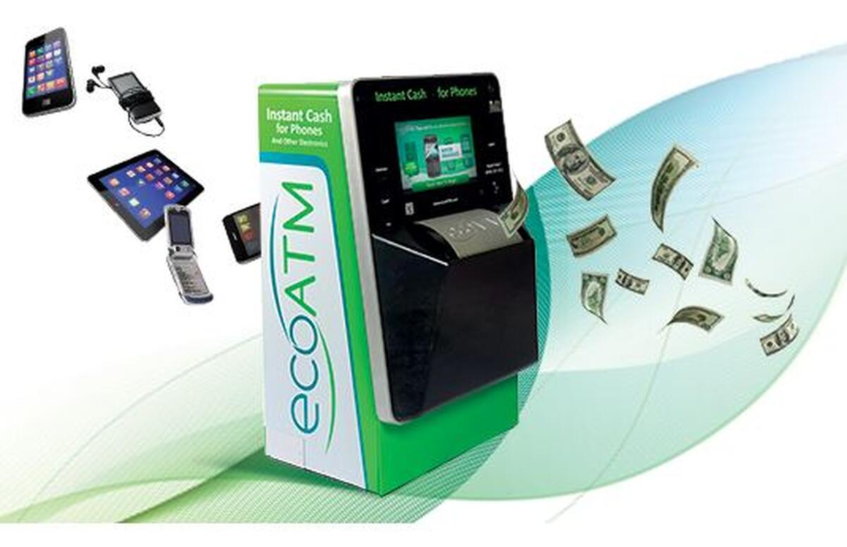
SOLUTION 1
SETTING UP ECO-ATMS AT EVERY STREET-:
sets up ATM-like machines in stores where consumers can trade in their old electronics for cash on the spot.
You feed it your old cell phone (MP3 players and tablets are also accepted) and the kiosk determines the value of your device based on model, condition and current market price.
Further we can modify them to give back customer some vouchers or coupons if they aren’t happy with the price of the machine.

Slide 4
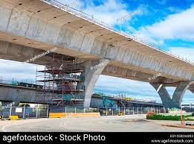
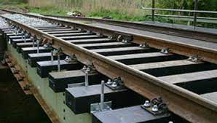
SOLUTION 2
By using the iron e-waste we can further modify and re-shape them into rectangular sleepers for the railway tracks.
In addition to this we can also use them to strengthen the pillars or the highways and long distance bridges.
MAKING CAST IRON SLEEPERS FOR THE RAILWAY TRACKS

Slide 5
SOLUTION 3
DESIGNING BORDER SECURITY SYSTEM
We can use e-waste to design stiff and strong gates which can serve as a security model at the borders,canals etc.
Moreover, we can build various lock-systems to ensure the safety of different military bases.
We can also use the reusable part to design the iron dome machines in order to strengthen our defence system.

Slide 6
HOW CAN WE IMPLEMENT IT….
CREATE TO INITIATE…..
BY BEING AN INTERN AT ANY PARTICULAR NGO OR START IT FROM THE BASICS.
BY SETTING UP AWARENESS CAMPAIGNS ,WEBINARS ETC.
BY PITCHING OUR IDEA TO THE TOP MNC’S , IN ORDER TO GET THE DESIRED AND ADEQUATE INVESTMENT.
BY BEING EMPLOYEE AT A FIRM AND USING THE ESSENTIAL ITEMS TO IMPLEMENT IT.

